Slide 1

Introducing the
CallBox 5000
IP Based Digital Call Logger
Affordable –Expandable - Upgradable

Slide 2
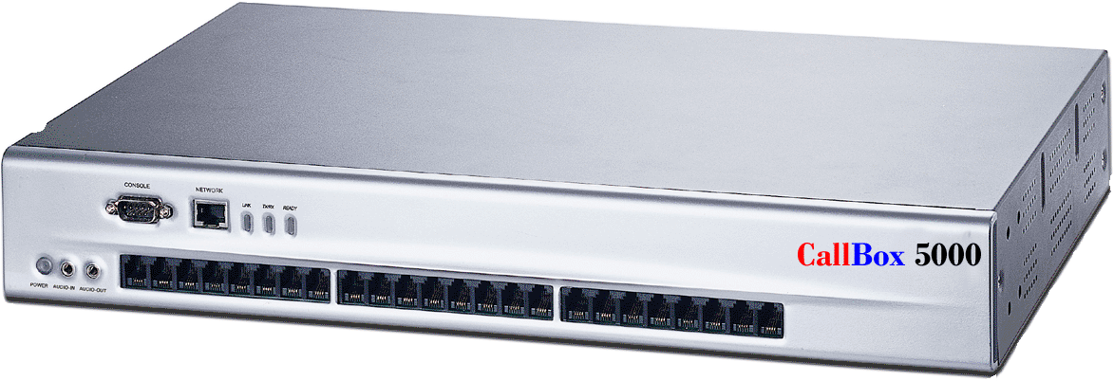
CallBox 5000
IP Based Digital Call Logger
The business management tool
For service oriented companies

Slide 3
.
Suitable for every type of business
Banks and Financial Institutions
Law Firms
Medical Offices
Public Service Organizations
Hotels, Rental Companies.
And more!

Slide 4
Ever wish you had a
recording of a customer
service dispute?
“He said….She said” disputes cost your
Company time, money and clients.

Slide 5
Our CallBox 5000 logs each
and every incoming and
outgoing call.. Up 24 lines on
a single logger…up to 1000
lines in a single network.

Slide 6
Log up to 40,000 hours of
Calls on a single CallBox
Locate one in each branch office
And you’ll be able to access any
Or all from the convenience of
Your desktop computer

Slide 7
CallBox 5000 is engineered
to operate over a Non-PC
dedicated hardware platform,
eliminating the vulnerability
of personal computers.

Slide 8
CallBox 5000 is also based
on a secure / dedicated
operating system, dramatically
raising the level of stability and
security.

Slide 9
CallBox 5000 utilizes
the 4 channel dedicated
modular upgrade capability,
tailors to your company’s
size and budget.

Slide 10
Search and Play
CallBox allows multiple users to Search & Play
simultaneously via TCP/IP protocol
Powerful Search by:
Last 10, Last 50, Logger ID, Date, Time, Extension Number,
Recording Channel, Caller ID, Trunk Line, Dialed Number,
and many more call attributes.
Small Footprint:
2.5”H x 10 ¾” D x 17 ½”W
Only 7.75 lbs!

Slide 11
CallBox 5000 is equipped with
a high performance HD
Capable of storing up to 40,000
hour/channel handling up to
up to 24 lines per unit. Backup
can also be done real-time or
by user defined schedule to any
available network device including HD, DVD
RAM, and MO.

Slide 12
CallBox 5000 System Functions
Single logger supports from 4 up to 24
recording channels.
Stackable up to 1000 recording channels.
Supports Windows 98, NT, 2000 and XP
Software Upgrade via Internet

Slide 13
Playback can be done by logger
(Speaker needed), Remotely by PC.
Skip Forward/Backward,
Continues Play, Selective Play and Volume
Control during record playback.
Files can be converted to .WAV format.

Slide 14
Multiple Levels of Administration
Up to 10 sets of different CallBox
administrators-Functions can be
independently assigned to
administrators, providing flexible COS.

Slide 15
CallBox
CD/RW Support Redundancy to HD, DAT, MO, DVD RAM, RAID1, RAID5
Supports FAT, FAT32, NTFS Format
.

Slide 16
.
System Functions
Recording Ring Beep
System Self-Diagnose, send E-mail and
system error beep.
Front Panel LED indicating the status of each recording
channel, power, and RX/TX standing.

Slide 17
CallBox Recording Parameters
Recording Schedule and Recording channels independently
define recording parameters with VOX (Hi/Mid/Low),
voltage and Max/Min recording time
.

Slide 18
Silence Detection, and CODEC.-Flexible Schedule and Record-on-Demand.
Recording Status Check by recording channel
.

Slide 19
.
Playback can be done by logger (speaker needed),
remotely by PC.
Skip Forward/Backward,

Slide 20
.
Continues Play, Selective
Play and Volume Control
during record playback.
Files can be converted to WAVE format.

Slide 21
.
Each logger comes with a
1 year full parts and labor
warranty plan and is upgradeable
to our mission Critical service plan
which gives you advance replacement
of any logger that encounters a
technical problem.

Slide 22

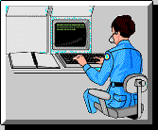
CallBox 5000 Affordable, IP Based Digital
IP Based Digital Voice / Call Logger Recorder
Capture
Analyze
Report
Recall
Record every call…incoming or outgoing.
Great training tool
Settles disputes over who said what.
Great productivity measurement tool

Slide 23
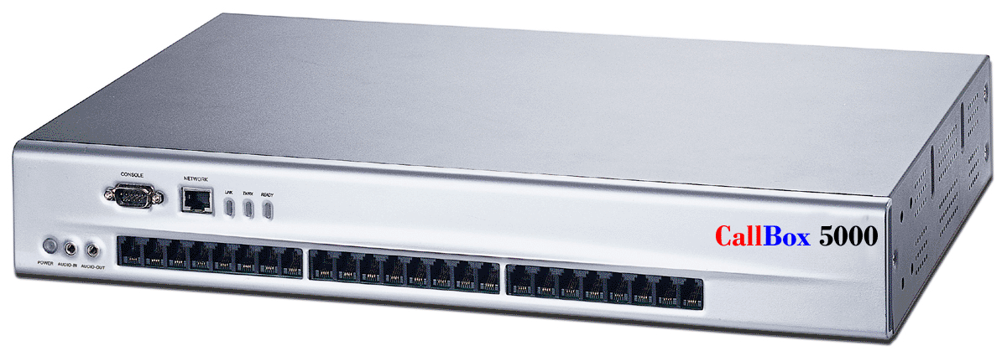
CallBox 5000 Affordable, IP Based Digital
New York
CallBox 5000
breaks the
boundary of traditional
PC-based loggers
by connecting
the administrator with multiple recording sites,
taking
call logging to a whole new level
Denver
Atlanta
Denver
Los Angeles
Washington
Live monitor calls from across the hall, across town
Or across the country.

Slide 24
CallBox 5000 Affordable, IP Based Digital
States Requiring One Party Notification
Alabama Alaska Arizona Arkansas Colorado District Of Columbia Georgia Hawaii Idaho Indiana | Iowa Kansas Kentucky Louisiana Maine Minnesota Mississippi Missouri Nebraska Nevada | New Jersey New Mexico New York North Carolina North Dakota Oklahoma Oregon Ohio Rhode Island South Carolina | South Dakota Tennessee Texas Utah Vermont Virginia West Virginia Wisconsin Wyoming

Slide 25
CallBox 5000 Affordable, IP Based Digital
States Requiring Two Party Notification
California Connecticut Delaware | Florida Illinois Massachusetts | Maryland Michigan Montana | New Hampshire Pennsylvania Washington

Slide 26
CallBox 5000 Affordable, IP Based Digital
Model Numbers | Factory Direct Agency Price
CV-CB 4P | includes 1 year parts and labor plan
CV-CB 8P | includes 1 year parts and labor plan
CV-CB 12P | includes 1 year parts and labor plan
CV-CB-16P | includes 1 year parts and labor plan
CV-CB 20P | includes 1 year parts and labor plan
CV-CB 24P | includes 1 year parts and labor plan
Expansion Card | includes 1 year parts and labor plan

Slide 27
CallBox 5000 Affordable, IP Based Digital
Model Number | Description
CV-AR- 1 | Advance replacement of any CV-CB
CV-SP-3 | Full 3 year Warranty Service Plan

Slide 28
For Additional Information
Call us today at
1-866-277-5098

